Slide 1

Hadoop: Past and Present
Andrew Wang | Software Engineer
April 25, 2013

Slide 2
About Me
2010: BS CS UVa
2012: MS CS UC Berkeley
AMP Lab alumni
Advised by Ion Stoica
Now: HDFS team at Cloudera

Slide 3
Outline
State of databases in 1999
Why is Hadoop displacing DB technology?
Core stack
HDFS and MapReduce
Rest of the Hadoop ecosystem
HBase, Pig, Hive, Oozie, Zookeeper, Flume, Impala, …

Slide 4

1999!

Slide 5
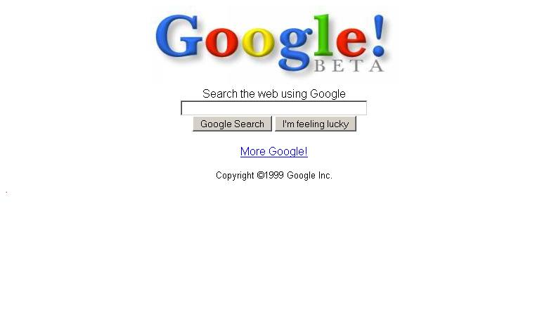

Slide 6
Indexing the Web
Web is huge
Hundreds of millions of pages in 1999
How do you index it?
Crawl all the pages
Rank pages based on relevance metrics
Build search index of keywords to pages
Do it in real-time!

Slide 7





Slide 8
Databases in 1999
Buy a really big machine
Install an expensive DBMS on it
Point your workload at it
Hope it doesn’t fail
Ambitious: buy another really big machine as a backup

Slide 9
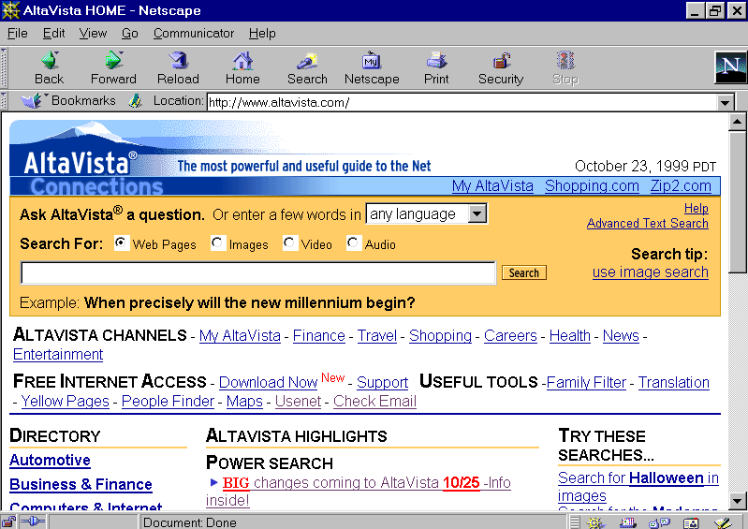

Slide 10
Database Limitations
Didn’t scale horizontally
High marginal cost ($$$)
No real fault-tolerance story
Vendor lock in ($$$)
SQL unsuited for search ranking
Complex analysis (PageRank)
Unstructured data

Slide 11
Google Does Something Different
Designed their own storage and processing infrastructure
Google File System and MapReduce
Goals: KISS
Cheap
Scalable
Reliable

Slide 12
Google Does Something Different
It worked!
Powered Google Search for many years
General framework for large-scale batch computation tasks
Still used internally at Google to this day

Slide 13
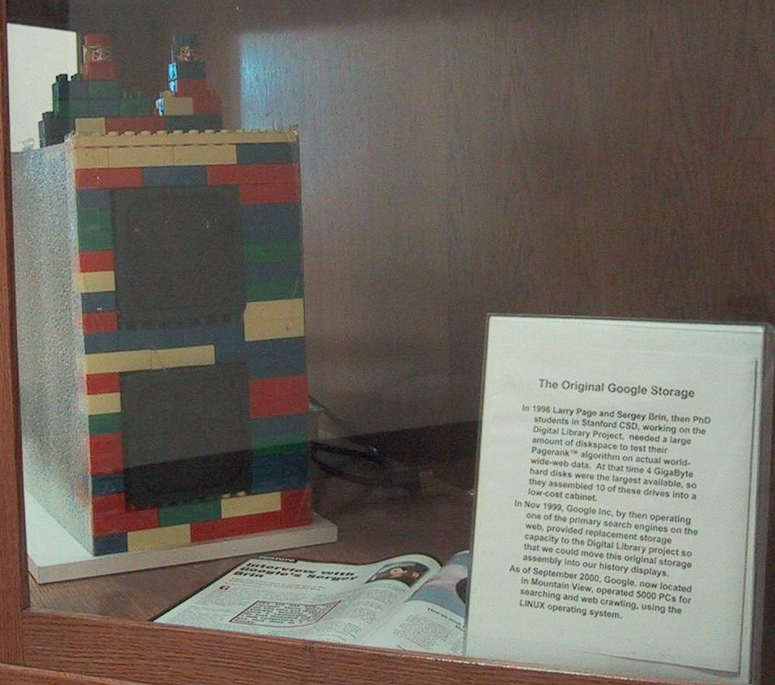

Slide 14
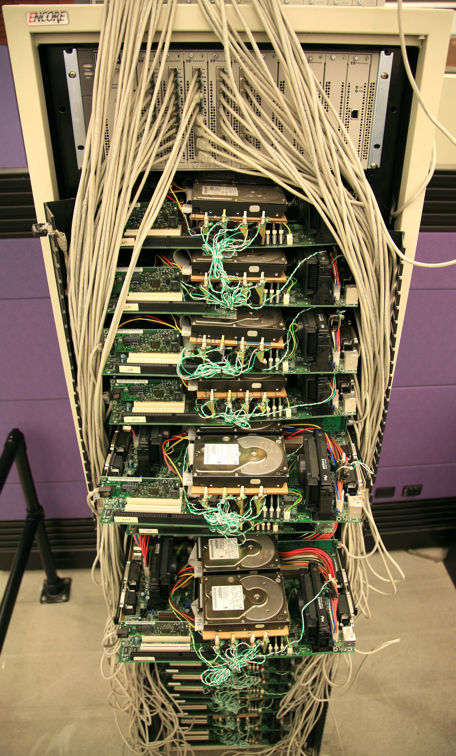

Slide 15
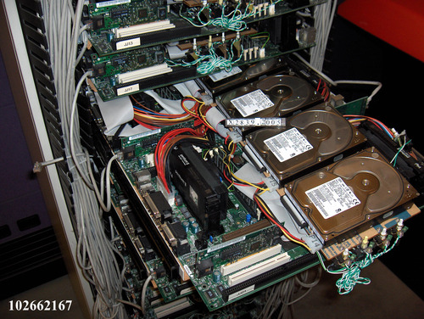

Slide 16
Google’s messages from the future
Google was benevolent enough to publish
2003: Google File System (GFS) paper
2004: MapReduce paper
Already mature technologies at this point

Slide 17
Google’s messages from the future
Community didn’t get it immediately
DB people thought it was silly
Non-Google weren’t at the same scale yet
Google had little interest in releasing GFS and MapReduce
Business was ads, not infrastructure

Slide 18
Birth of Hadoop
Doug Cutting and Mike Cafarella
Nutch
Open-source search platform
Ran into scaling issues
4 nodes
Hard to program
Hard to manage
Immediate application for GFS and MR

Slide 19

Birth of Hadoop
2004-2006: Implemented GFS/MR and ported Nutch to it
2006: Spun out into Apache Hadoop
Name of Doug’s son’s stuffed elephant

Slide 20
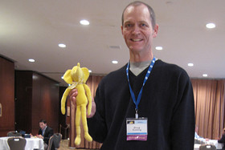
Birth of Hadoop

Slide 21
Summary
The web is huge and unstructured
Databases didn’t fit the problem
Didn’t scale, expensive, SQL limitations
Google did their own thing: GFS + MR
Hadoop is based on the Google papers

Slide 22

HDFS and MapReduce

Slide 23
HDFS
Based on GFS
Distributed, fault-tolerant filesystem
Primarily designed for cost and scale
Works on commodity hardware
20PB / 4000 node cluster at Facebook

Slide 24
HDFS design assumptions
Failures are common
Massive scale means more failures
Disks, network, node
Files are append-only
Files are large (GBs to TBs)
Accesses are large and sequential

Slide 25
Quick primers
Filesystems
Hard drives
Datacenter networking

Slide 26
Quick filesystem primer
Same concepts as the FS on your laptop
Directory tree
Create, read, write, delete files
Filesystems store metadata and data
Metadata: filename, size, permissions, …
Data: contents of a file
Other concerns
Data integrity, durability, management

Slide 27
Quick disk primer
Disk does a seek for each I/O operation
Seeks are expensive (~10ms)
Throughput / IOPS tradeoff
100 MB/s and 10 IOPS
10MB/s and 100 IOPS
Big I/Os mean better throughput

Slide 28
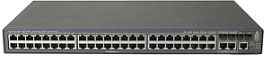
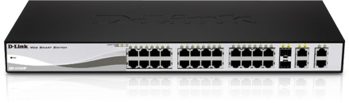
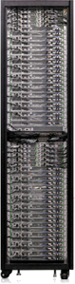
Quick networking primer
Core switch
Top-of-rack switch
Rack

Slide 29
Quick networking primer
40 Gbit
10 Gbit

Slide 30
Quick networking primer
Slow across racks
Fast within a rack

Slide 31
HDFS Architecture
NameNode
Metadata
Paths, filenames, file sizes, block locations, …
DataNode
DataNode
DataNode
DataNode

Slide 32
HDFS Architecture
NameNode
Data
Blocks, checksums
DataNode
DataNode
DataNode
DataNode

Slide 33
HDFS Architecture
NameNode
DataNode
DataNode
DataNode
DataNode
Rack 1
Rack 2

Slide 34
HDFS Architecture
NameNode
DN 1
DN 2
DN 3
DN 4
Rack 1
Rack 2

Slide 35
HDFS Write Path
NameNode
create(“/tmp/myfile”)
Client
Write to [DN4,DN3,DN2]
[DN3,DN2]
[DN2]
DN 1
DN 2
DN 3
DN 4
Rack 1
Rack 2

Slide 36
HDFS Write Path
NameNode
Client
Write Pipeline
data
data
data
DN 1
DN 2
DN 3
DN 4
Rack 1
Rack 2

Slide 37
HDFS Write Path
NameNode
close()
NN stores DN locations
Client
DN 1
DN 2
DN 3
DN 4
Rack 1
Rack 2

Slide 38
HDFS Write Path
Talk to NameNode
Store metadata for new file
Get topology-aware list of DataNodes
Setup the write pipeline
Stream data to pipeline
Tell NameNode when done

Slide 39
HDFS Read Path
NameNode
open(“/tmp/myfile”,“r”)
Client
Read from [DN4,DN3,DN2]
data
read
DN 1
DN 2
DN 3
DN 4
Rack 1
Rack 2

Slide 40
HDFS Fault-tolerance
Many different failure modes
Disk corruption, node failure, switch failure
Primary concern
Data is safe!!!
Secondary concerns
Keep accepting reads and writes
Do it transparently to clients

Slide 41
HDFS DataNode Failure
NameNode
open(“/tmp/myfile”,“r”)
Client
Read from [DN4,DN3,DN2]
read
read
DN 1
DN 2
DN 3
DN 4
Rack 1
Rack 2

Slide 42
HDFS NameNode Failure
NameNode
open(“/tmp/myfile”,“r”)
NameNode
Client
open(“/tmp/myfile”,“r”)
DN 1
DN 2
DN 3
DN 4
Rack 1
Rack 2

Slide 43
Other HDFS features
NameNode federation
Storage block pools
Snapshots (new!)
Future
Hierarchical storage management
Quality-of-Service
NameNode and DataNode scalability

Slide 44
MapReduce
Programming and execution framework
Taken from functional programming
Map – operate on every element
Reduce – combine and aggregate results
Abstracts storage, concurrency, execution
Just write two Java functions
Contrast with MPI

Slide 45
MapReduce
Constrained, but general
Can do custom ML not possible in SQL
Not as efficient as a DB for some queries
No update in place
Take data in, transform, write new data out
Makes fault-tolerance easier

Slide 46
MapReduce Architcture
NameNode
DN 1
DN 2
DN 3
DN 4
Rack 1
Rack 2

Slide 47
MapReduce Architcture
NameNode
JobTracker
Gateway for users
Assigns tasks to TaskTrackers
Tracks job status
TT 1
TT 2
TT 3
TT 4
DN 1
DN 2
DN 3
DN 4
Rack 1
Rack 2

Slide 48
MapReduce Architcture
NameNode
JobTracker
TaskTrackers execute Map and Reduce tasks assigned by JT
TT 1
TT 2
TT 3
TT 4
DN 1
DN 2
DN 3
DN 4
Rack 1
Rack 2

Slide 49
Word Count Example

Slide 50
MapReduce Architcture
NameNode
JobTracker
wordcount(<files>)
[cat, 1]
[the, 1]
[dog, 1]
[sat, 1]
M1
M2
M3
M4
R1
TT 1
TT 2
TT 3
TT 4
DN 1
DN 2
DN 3
DN 4
Rack 1
Rack 2

Slide 51
MapReduce Architcture
NameNode
JobTracker
wordcount(<files>)
[mat, 1]
[cat, 1]
[bad, 1]
[for, 1]
M1
M2
M3
M4
R1
TT 1
TT 2
TT 3
TT 4
DN 1
DN 2
DN 3
DN 4
Rack 1
Rack 2

Slide 52
MapReduce Architcture
NameNode
JobTracker
wordcount(<files>)
[a, 5]
[cat, 2]
[dog, 1]
[the, 4]
[mat, 1]
M5
M6
M7
M8
R1
TT 1
TT 2
TT 3
TT 4
DN 1
DN 2
DN 3
DN 4
Rack 1
Rack 2

Slide 53
MapReduce Architcture
NameNode
JobTracker
wordcount(<files>)
[a, 5]
[cat, 2]
[dog, 1]
[the, 4]
[mat, 1]
R1
TT 1
TT 2
TT 3
TT 4
DN 1
DN 2
DN 3
DN 4
Rack 1
Rack 2

Slide 54
MapReduce Architcture
NameNode
JobTracker
wordcount(<files>)
[a, 5]
[cat, 2]
[dog, 1]
[the, 4]
[mat, 1]
We’re working on it! ☺
R1
TT 1
TT 2
TT 3
TT 4
DN 1
DN 2
DN 3
DN 4
Rack 1
Rack 2

Slide 55
Summary
GFS and MR co-design
Cheap, simple, effective at scale
Fault-tolerance baked in
Replicate data 3x
Incrementally re-execute computation
Avoid single points of failure
Held the world sort record (0.578TB/min)

Slide 56
Hadoop ecosystem

Slide 57
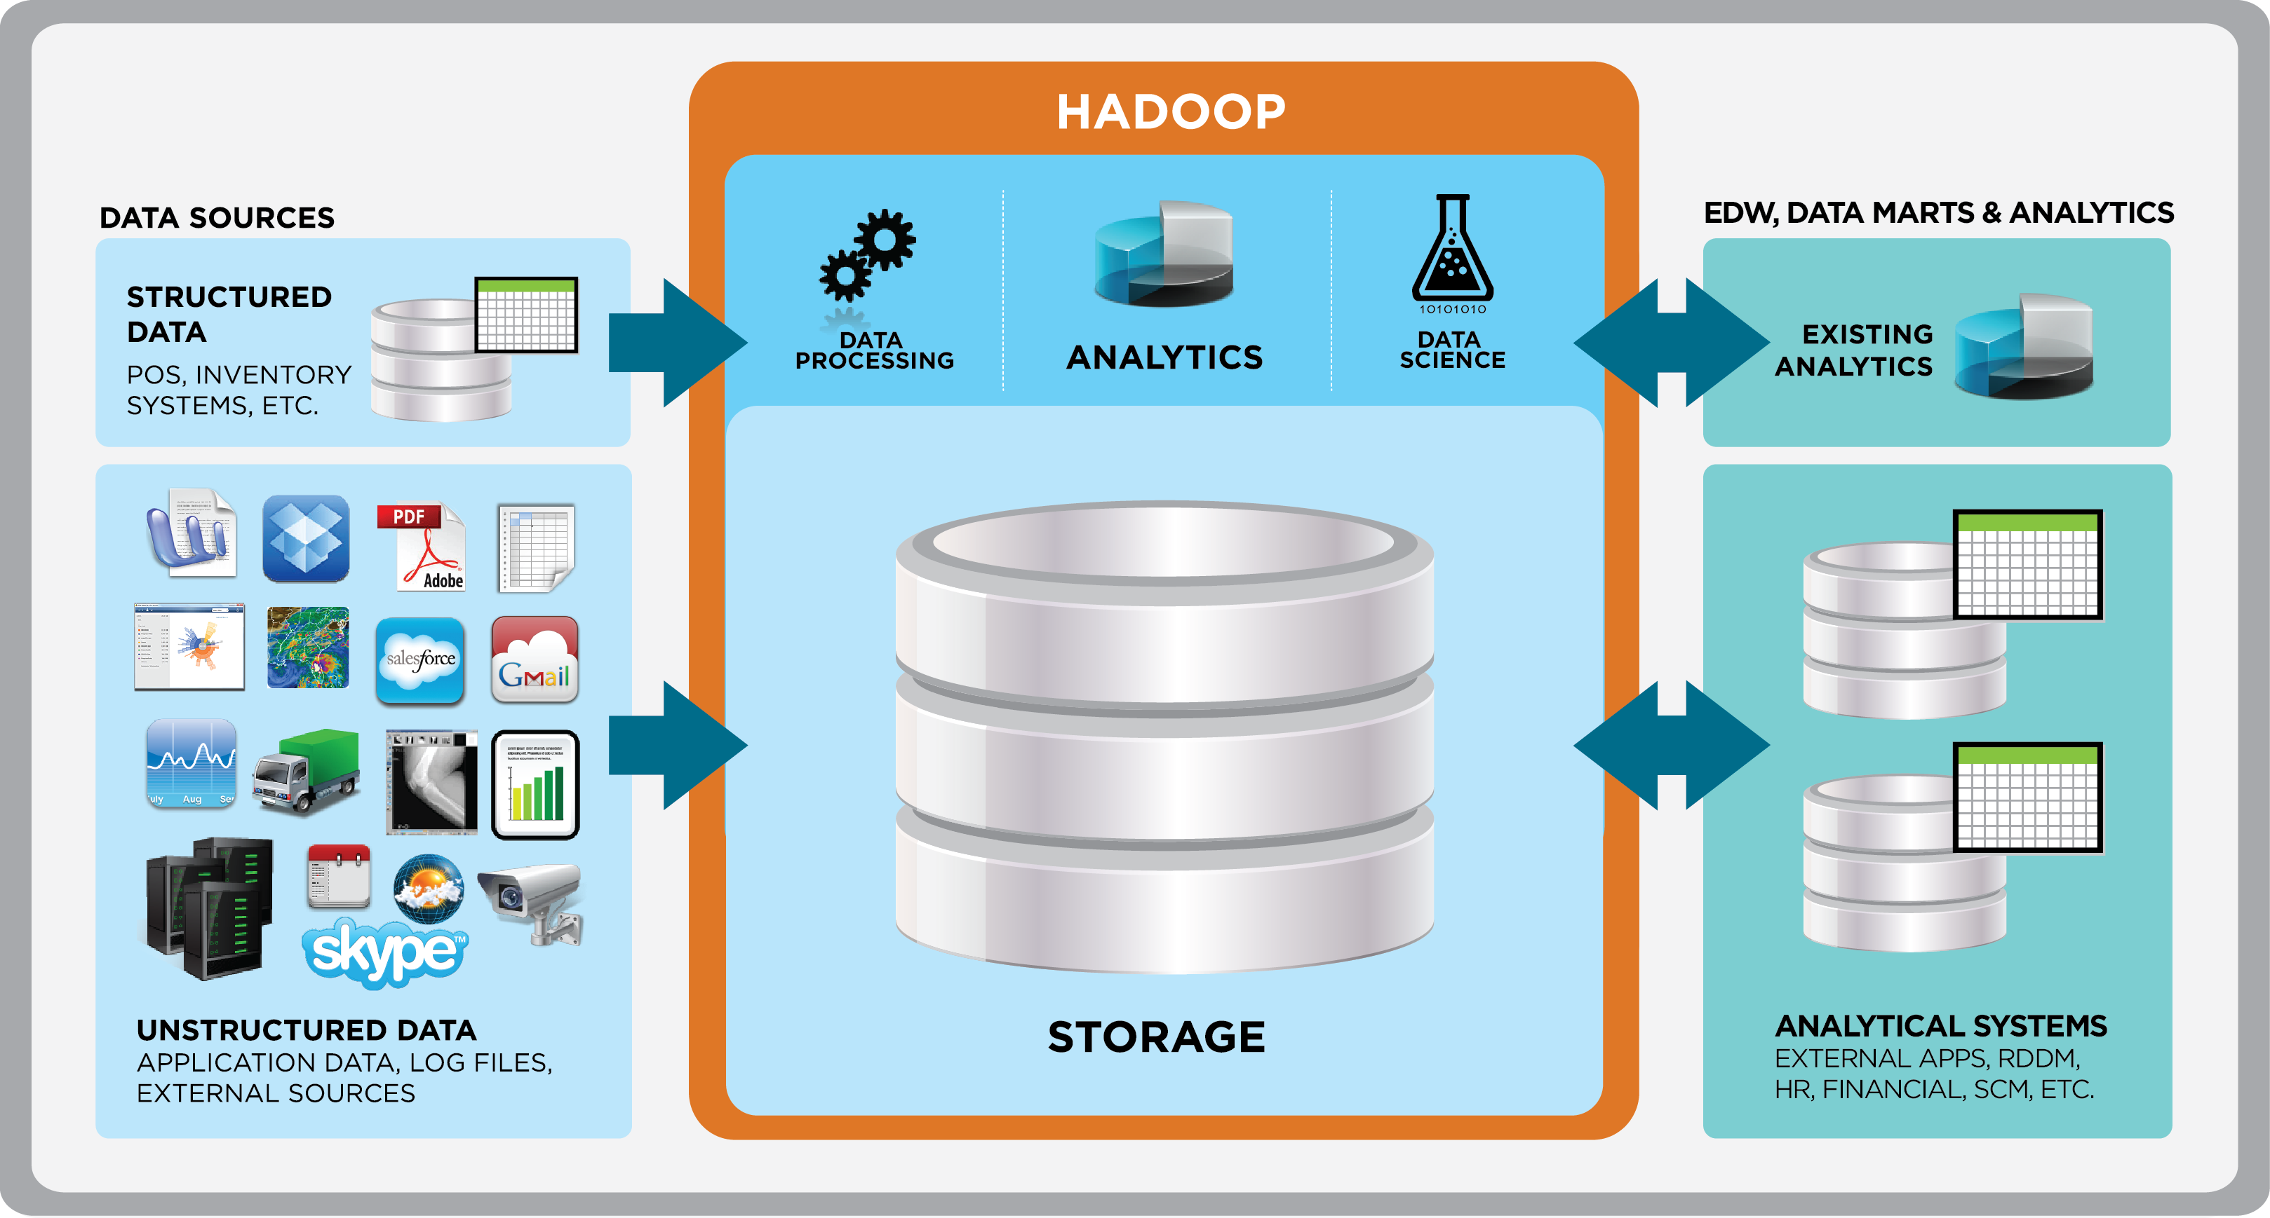
Data Processing Pipeline

Slide 58

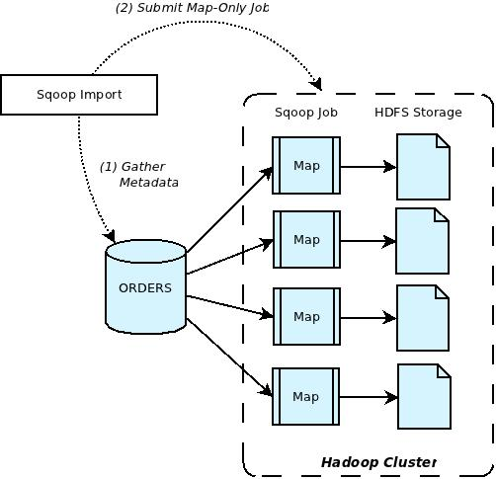
Sqoop
Performs bidirectional data transfers between Hadoop and almost any SQL database with a JDBC driver

Slide 59
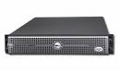
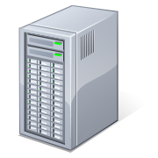



Flume
A streaming data collection and aggregation system for massive volumes of data, such as RPC services, Log4J, Syslog, etc.
Client
Agent
Client
Agent
Client
Agent
Client

Slide 60

Hive
Relational database abstraction using a SQL like dialect called HiveQL
Statements are executed as one or more MapReduce Jobs
SELECT
s.word, s.freq, k.freq
FROM shakespeare
JOIN ON (s.word= k.word)
WHERE s.freq >= 5;

Slide 61

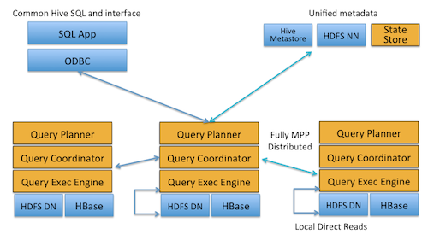
Impala
Modern MPP database built on top of HDFS
Really fast! Written in C++
10-100x faster than Hive

Slide 62

Pig
High-level scripting language for for executing one or more MapReduce jobs
Created to simplify authoring of MapReduce jobs
Can be extended with user defined functions
emps = LOAD 'people.txt’ AS (id,name,salary);
rich = FILTER emps BY salary > 200000;
sorted_rich = ORDER rich BY salary DESC;
STORE sorted_rich INTO ’rich_people.txt';

Slide 63

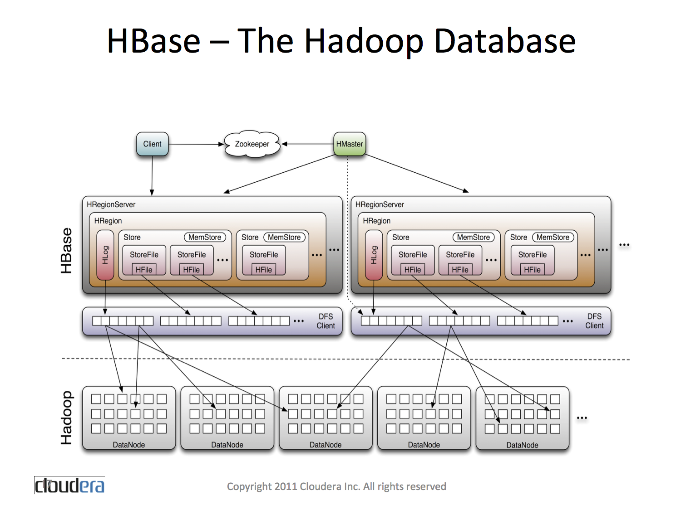
HBase
Low-latency, distributed, columnar key-value store
Based on BigTable
Efficient random reads/writes on HDFS
Useful for frontend applications
63

Slide 64

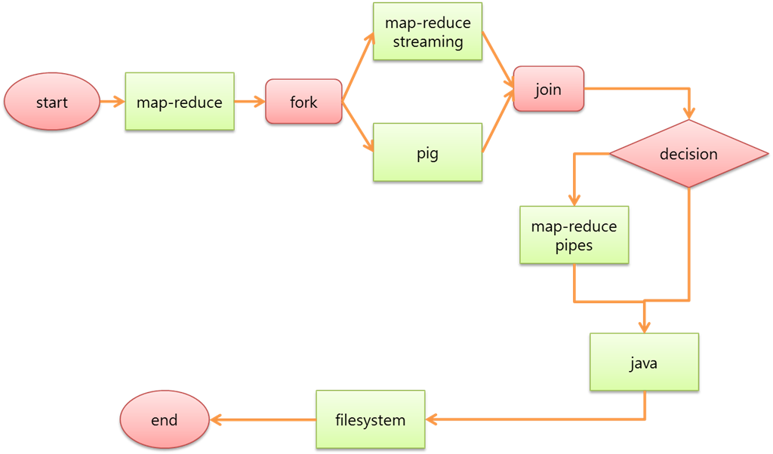
Oozie
A workflow engine and scheduler built specifically for large-scale job orchestration on a Hadoop cluster

Slide 65

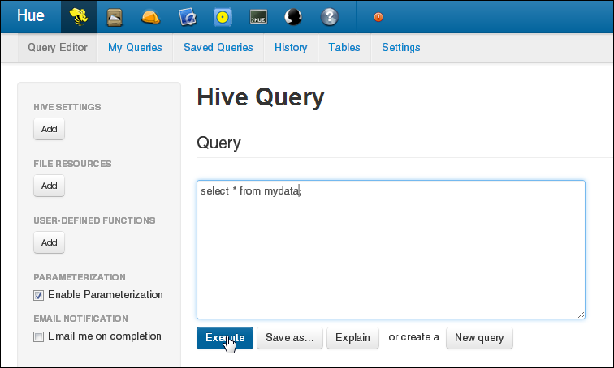
Hue
Hue is an open source web-based application for making it easier to use Apache Hadoop.
Hue features
File Browser for HDFS
Job Designer/Browser for MapReduce
Query editors for Hive, Pig and Cloudera Impala
Oozie

Slide 66

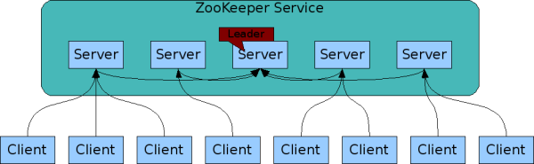
Zookeeper
Zookeeper is a distributed consensus engine
Provides well-defined concurrent access semantics:
Leader election
Service discovery
Distributed locking / mutual exclusion
Message board / mailboxes

Slide 67

Cloudera Manager
End-to-End Administration for CDH
1
Manage
Easily deploy, configure & optimize clusters
2
Monitor
Maintain a central view of all activity
3
Diagnose
Easily identify and resolve issues
4
Integrate
Use Cloudera Manager with existing tools

Slide 68











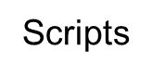

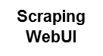

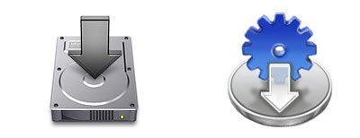



Cloudera Manager
DEPLOYMENT & CONFIGURATION | MONITORING | WORKFLOWS | EVENTS & ALERTS | LOG SEARCH | DIAGNOSTICS | REPORTING | ACTIVITY MONITORING
DO-IT-YOURSELF
+
WITH CLOUDERA

Slide 69
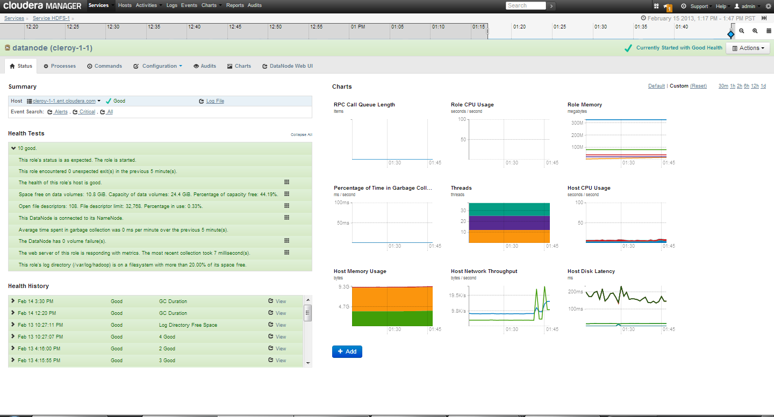
View Service Health & Performance
Cloudera Manager Key Features

Slide 70

Thank You!
andrew.wang@cloudera.com
@umbrant

